Slide 1

Recent Advances in Machine Learning
Long-term activity recognition from the wrist
SoSe 2021
Kaushik Goud Chandapet - 1536199
Nishanth Iruthayaraj - 1522044
Venkata Sriram Pallav Pingala - 1613117

Slide 2
Objective
The objective is to apply any Deep Learning or Classical Machine Learning architectures to predict the basketball-related activities of a subject.
Body-worn Sensors
E-sensor - worn on the head (as an earbud)
Bangle.js - worn on the wrist of the dominant hand as well on the dominant ankle
Wrist and ankle worn sensors - 100Hz and E-sensor - 50Hz

Slide 3
Data Preprocessing and its challenges
Data from the given 3 sensors is recorded for two participants(subjects) performing basketball activities at different time.
The unix timestamp is decoded into Local timezone (Date and Time).
Timestamps of the data is corrected based on the sensor frequency.
To match both E-sensor and Bangle.js sensor’s data, upsampling is performed by means of interpolation.
Concatenating data from all the sensors into a single dataframe per subject.
The labels are set(corrected) manually as per the timestamps from videos.
Concatenating data from both the subjects into a single dataframe.
Normalise the final dataset using Zero mean and Unit Variance standardization

Slide 4
Sliding Window
Sliding window is the way to restructure a time series dataset by splitting the entire data into small sized windows of particular window length with a desired overlapping ratio.
Classical ML Architecture
Deep Learning Architecture
K Nearest Neighbors
Support Vector Machines
Conv2D Neural Network
LSTM Neural Network

Slide 5
Train Test Splits
K-fold:
K-fold divides all the samples(n) into k groups of samples, called folds of equal sizes (if possible). The prediction function is learned using k−1 folds and the fold left out is used for test.
Repeated k-fold:
Repeated k-fold repeats k-fold n times. It can be used when one requires to run k-fold n times, producing different splits in each repetition.
Stratified k-fold:
Stratified k-fold is a variation of k-fold which returns stratified folds: each set contains approximately the same percentage of samples of each target class as the complete set.
Repeated Stratified k-fold:
Repeats Stratified k-fold n times with different randomization in each repetition

Slide 6
Types of Validation
Normal Cross Validation: The entire data is separated into features and target. Major part of data is used for training the model and the remaining data is used for validating the model.
Per Participant Cross Validation: The above mentioned procedure is followed on both subjects individually.
Cross Participant Cross Validation: The data of subject1 is used for training the model and subject 2 for validating the model. The same method is also performed vice-versa

Slide 7
Metrics
Model Accuracy: how often is the classifier correct?
Ratio of correctly predicted observation to the total observations.
Model Precision: What proportion of positive identifications was actually correct?
Ratio of correctly predicted positive observations to the total predicted positive observations
Model Recall: What proportion of actual positives was identified correctly?
Ratio of correctly predicted positive observations to the all observations in actual class.
Model f1_score: weighted average of the precision and recall

Slide 8
Classical Machine Learning Architectures
There are many different types of classical machine learning algorithms that can be applied to the Human Activities Recognition problem. Of them, we have worked with the 2 famous architectures:
K nearest neighbors is one of the simplest Machine Learning algorithms that stores all available cases and classifies new cases based on a similarity measure (e.g., distance functions). Thus, it assumes that similar things exist in close proximity.
Support vector machines is also a simple Machine Learning algorithm whose objective is to find a hyperplane in an N-dimensional space(N — the number of features) that distinctly classifies the data points.

Slide 9
K-nearest neighbors (k-NN) algorithm
k-NN algorithm can be used to solve both classification and regression problems. It’s easy to implement and understand, but has a major drawback of becoming significantly slower as the size of that data in use grows.
It works by finding the distances between a query and all the examples in the data, selecting the specified number of examples (K) closest to the query, then votes for the most frequent label (in the case of classification) or averages the labels (in the case of regression).
Choosing the right K for our data is done by trying several Ks and picking the one that works best.

Slide 10
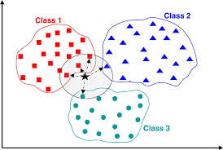
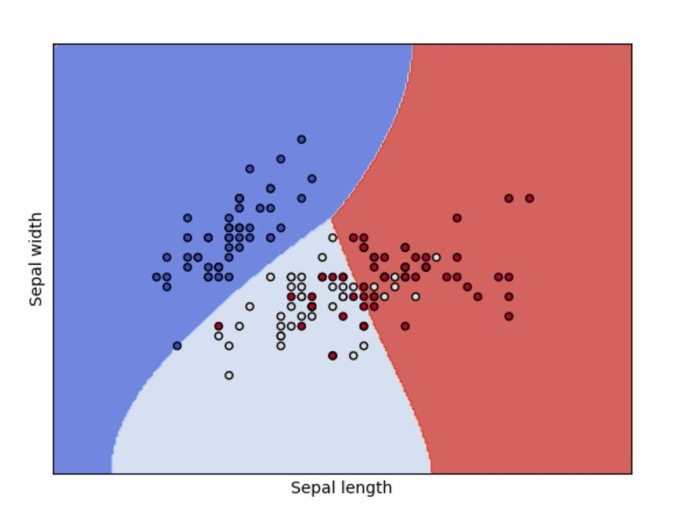
k-NN algorithm
SVM algorithm

Slide 11
Support vector machines (SVM) algorithm
Support Vector Machine (SVM) can be used for both classification or regression challenges.
It works really well with a clear margin of separation and is effective in high dimensional spaces. It is effective in cases where the number of dimensions is greater than the number of samples.
It doesn’t perform well when we have large data set because the required training time is higher or when the data set has more noise i.e. target classes are overlapping.

Slide 12
Parameters for Classical approaches
For kNN : n_neighbors=5
For SVM : kernel='rbf', C=1, gamma='auto'
Sliding Window: Window size: 100, Overlap: 70
For Repeated_K-Fold (Normal and per participant), n_splits=10, n_repeats=5
For Repeated_Stratified_K-Fold (Cross participant), n_splits=2(no. of subjects) and n_repeats=5

Slide 13
Results from Classical approaches
Overall Dataset:(Repeated k-fold)
kNN -
Accuracy: 0.6942456499097018
f1_score: 0.6746951168377457
Confusion matrix - [[ 25 0 14 0 5 0]
[ 4 17 22 0 16 13]
[ 1 0 102 0 11 1]
[ 0 0 7 41 11 7]
[ 0 0 3 0 56 0]
[ 0 0 4 0 10 87]]
SVM -
Accuracy: 0.9208485184371206
f1_score: 0.9209304788829862
Confusion matrix - [[41 1 1 0 1 0]
[ 1 70 1 0 0 0]
[ 3 4 97 2 6 3]
[ 0 4 0 62 0 0]
[ 0 0 1 0 58 0]
[ 0 0 2 2 0 97]]

Slide 14
Per_Subject_Validation:(Repeated k-fold)
kNN - Accuracy: 0.720734629460255
f1_score: 0.6932570690801877
SVM - Accuracy: 0.9281755298603903
f1_score: 0.9280548642787795
Cross_Subject_Validation:(Repeated Stratified k-fold)
kNN - Accuracy: 0.6772464190269888
f1_score: 0.647428688772531
SVM - Accuracy: 0.9146706042293606
f1_score: 0.9145029480061128

Slide 15
Convolutional Neural Network
It is a type of deep neural network which is used to analyze the visual data like images, this can also be used to analyse the time series data.
The input is an image or a frame , which consists of the data values of the pixels or the sensor values grouped together to preserve the time consistency.
A filter/ kernel is used to slide along the input features and provide translation equivalent responses(convoluted outputs) known as feature maps.
The advantage of this is that it reduces time by processing the data into a form which is easier to process without losing the features.

Slide 16

Figure : Convolutional Neural Network Architecture
Source:https://towardsdatascience.com/

Slide 17
Approach
As it is a time series data to preserve the data integrity the data needs to be combined into small packets of duration called frames/windows.
Depending on the frequency of measurement by the sensors , a certain period of data is taken a single frame and then the model is built upon it using these frames/windows as the input.
Here the duration is taken to be 1 second . This implies that each frame(list/window) has the sensor data for a duration of 1 seconds. Also each frame in frames differs by 0.5 seconds as calculated in the previous cell.
On top of these frames the kernel is applied to get the convoluted outputs
These are flattened and passed into dense network.
Dropout layers are used in between to avoid overfitting.
Results are obtained at the end of the deep neural networks for each class of activity.

Slide 18
Result from Convolutional model
Normal Cross Validation, Data split: Stratified K-Fold, Model: Conv2d
Accuracy : 0.9531
F1_score : 0.9492
Cross Participants Cross Validation, Data split: Train Test Split, Model : Conv2d
Accuracy : 0.9569
F1_score : 0.9566

Slide 19
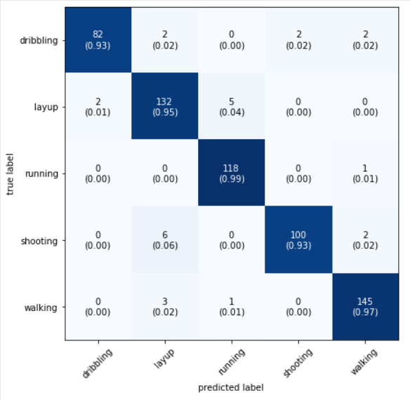
Normal Cross Validation, Model: Conv2d
Confusion Matrix

Slide 20
LSTM – Long short-term memory NN
Type of artificial recurrent neural network(RNN)
Suitable for sequences of data e.g. human activity, speech or video
Thereby it has the property of selectively remembering patterns for long durations of time
Well-suited to classifying, processing and making predictions based on time series data, since there can be lags of unknown duration
LSTM unit is composed of a cell, an input gate, an output gate and a forget gate
The cell remembers values over arbitrary time intervals

Slide 21
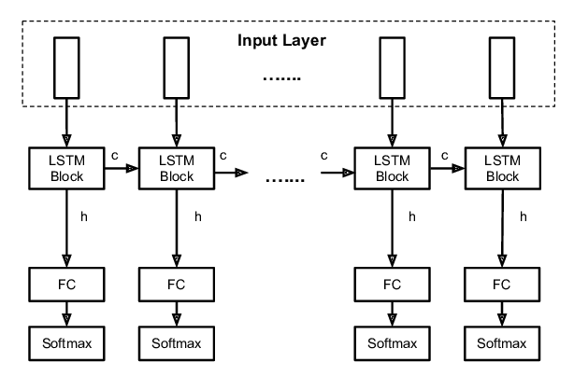
Figure : LSTM Neural Network Architecture
Source : https://www.google.com/search?q=lstm+with+fully+connected+layer&sxsrf=ALeKk00uc6U4aw0WCtgQZSroM7ImW4jUHQ:1626866037444&source=lnms&tbm=isch&sa=X&ved=2ahUKEwivu4iihPTxAhXVQeUKHbC9AMYQ_AUoAXoECAEQAw#imgrc=e9CUE-8OWGJZrM

Slide 22
Challenges faced during training
Giving correct input shape for LSTM layer after applying sliding window on the final dataframe
There should be a dropout layer after every LSTM layer in order to reduce the effect of overfitting
Therefore more nodes are required in the layer when using the dropout and the activities are classified finally at the output
Since LSTMs are stochastic, we will get a different diagnostic plot for each run.

Slide 23
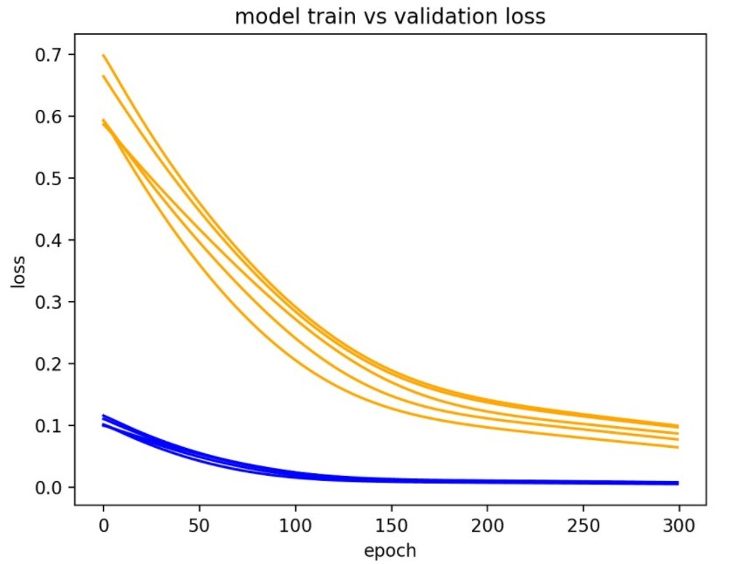
An example of LSTMs with different diagnostic plot
Figure : LSTM model with multiple diagnostic plot
Source : https://machinelearningmastery.com/diagnose-overfitting-underfitting-lstm-models/

Slide 24
Result from LSTM model
Normal Cross Validation, Data split: Stratified K-Fold, Model: LSTM
Accuracy : 0.8535
F1_score : 0.8501
Confusion_matrix : Null, dribbling, layup, running, shooting, walking
[[84 2 0 2 0 0]
[ 7 32 7 0 0 0]
[ 5 0 57 5 2 5]
[ 5 0 0 51 3 2]
[ 2 4 0 0 46 12]
[ 0 0 4 0 1 70]]

Slide 25
SUB 1 Cross Validation,Data split: Stratified K-Fold, Model : LSTM
Accuracy : 0.8573
F1_score : 0.8553
SUB 2 Cross Validation,Data split: Stratified K-Fold, Model : LSTM
Accuracy : 0.8432
F1_score : 0.8436
Cross Participants Cross Validation,Data split: Stratified K-Fold, Model : LSTM
Accuracy : 0.7647
F1_score : 0.7643

Slide 26
Comparison:
Models: (Accuracy) | Overall Dataset: | Per_Subject_Validation: | Cross_Subject_Validation
k-NN algorithm | 0.6942 | 0.7207 | 0.6772
SVM algorithm | 0.9208 | 0.9282 | 0.9147
CNN | 0.9531 | 0.9602 | 0.9569
LSTM NN | 0.8535 | 0.8573 | 0.7647

